Slide 1
JDI Settings

Slide 2

PLAN
UI Objects. JDI
JDI. Composite elements
JDI Settings
JDI for any UI

Slide 3
AGENDA
Test project from scratch
Test settings
Customization
Preconditions
Parallel run
Logging
Enums
Matchers

Slide 4
New project

Slide 5

Jdi setup
Maven
, Gradle, Ivy
<dependency>
<groupId>com.epam.jdi</groupId>
<artifactId>jdi-uitest-web</artifactId>
<version>1.0.67</version>
</dependency>
https://github.com/epam/JDI-Examples

Slide 6

Demo: Test project from scratch
Notes:
Demo Элементы на UI

Slide 7
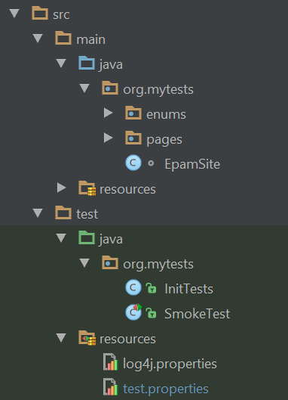
structure
test.properties
log properties
ui objects
test init
tests

Slide 8
Test properties
driver=chrome
timeout.wait.element=10
domain=https://www.epam.com/
driver.getLatest=true
search.element.strategy=strict | soft
browser.size=1800X1000
demo.mode=false | true
#multithread=true
#run.type=local | remote
screenshot.strategy=on fail | on | off

Slide 9
logging
Log4J
log4j.rootLogger = info, console
log4j.appender.console = org.apache.log4j.ConsoleAppender
log4j.appender.console.layout = org.apache.log4j.PatternLayout
log4j.appender.console.layout.ConversionPattern = %m%n
log4j.rootLogger = debug|error, file, HTML, dailylog
log4j.appender.file=org.apache.log4j.RollingFileAppender
log4j.appender.file.File=target/.logs/events.log
log4j.appender.file.layout.ConversionPattern= %d{yyyy-MM-dd HH:mm:ss} %-5p %c{1}:%L - %m%n
log4j.appender.file.layout=org.apache.log4j.PatternLayout

Slide 10
Ui objects & tests
EpamSite (Site)
HomePage(Page)
SearchSection (Search)
SearchField(TextField)
SearchButton(Button)
Invitation(Text)
ContactPage(Page)
ContactForm(Form)
…
Description(Text)
@BeforeSuite(alwaysRun = true)
public static void setUp() {
WebSite.init(EpamSite.class);
}

Slide 11
Demo: Test settings
Notes:
Demo Элементы на UI

Slide 12
Custom actions
public Dropdown<Types> productTypes
= new Dropdown<Types>() {
@Override
public void selectAction(String name) {
super.selectAction(name);
label.click();
}
};

Slide 13
Custom elements
public class TreeDropdown<T extends Enum> extends Dropdown<T> {
…
@Override
protected void selectAction(String name) {
expandAction();
String[] nodes = name.split(" > ");
SearchContext context = getDriver();
if (treeLocators.size() >= nodes.length)
for (int i=0; i < nodes.length; i++) {
String value = nodes[i];
context = first(context.findElements(treeLocators.get(i)),
el -> el.getText().equals(value));
new Clickable((WebElement) context).click();
}
}
}

Slide 14
Custom scenarios
@BeforeSuite (alwaysRun = true)
public static void setUp() {
ActionScenrios.actionScenario = (element, actionName, jAction, level) -> {
logger.info(format("Do '%s' action", actionName));
jAction.invoke();
};
ActionScenrios.resultScenario = (element, actionName, jAction, logResult, level) -> {
logger.debug(format("Do '%s' action", actionName));
Object result = jAction.get();
logger.info(format("Get '%s' action result: %s", actionName, result));
return result;
};
}

Slide 15
Element search
@BeforeSuite (alwaysRun = true)
public static void setUp() {
SeleniumDriverFactory.elementSearchCriteria =
el -> el.isEnabled() && el.isDisplayed();
// el -> el != null;
};
@Test()
public void simpleTest() {
sumResult.avatar.localElementSearchCriteria
= el -> el.getText().equals(“5”);
};

Slide 16
Demo: customization
Notes:
Demo Элементы на UI

Slide 17
No test dependencies
@Test(dependsOnMethods = “loginTest”)
public void simpleTest() {
…
};
@Test(dependsOnGroups = “smoke”)
public void simpleTest() {
…
};

Slide 18
preconditions
Independent tests
Time optimization
JDI Page precondition
homePage.isOpened();
PRECONDITION
JDI State precondition
IsInStateCheckAction
MoveToStateAction
PreconditionsState.isInState(LOGGED_IN)
or
isInState(LOGGED_IN)

Slide 19
preconditions
public enum Preconditions implements IPreconditions {
CALC_INIT(() -> calculator.value == 0,
() -> { calculator.clear();
calculator.clearMemeory() }),
CAREERS_PAGE("/careers");
….
}

Slide 20
Demo: preconditions
Notes:
Demo Элементы на UI

Slide 21
Using enums

Slide 22
Enums in Complex elements
public Menu<Options> topMenu;
public enum Options {
Home, About, Contacts }
topMenu.select(Options.About);
topMenu.select(About);
public Dropdown<Colors> colors;
public Tabs<Areas> areas;
public Checklist<Settings> settings;
public ComboBox<Tags> tags;
public DropList<Sizes> shirtSizes;
public Selector<VoteOptions> vote;
public RadioButtons<Ratings> rating;
public enum Options {
Home(‘option-1’),
About(‘option-3’),
public String value;
Options (String value) { this.value = value; }
@Override
public String toString() { return value; }
}

Slide 23
logger

Slide 24
log4g
Log4J
log4j.rootLogger = info, console
log4j.appender.console = org.apache.log4j.ConsoleAppender
log4j.appender.console.layout = org.apache.log4j.PatternLayout
log4j.appender.console.layout.ConversionPattern = %m%n
log4j.rootLogger = debug|error, file, HTML, dailylog
log4j.appender.file=org.apache.log4j.RollingFileAppender
log4j.appender.file.File=target/.logs/events.log
log4j.appender.file.layout.ConversionPattern= %d{yyyy-MM-dd HH:mm:ss} %-5p %c{1}:%L - %m%n
log4j.appender.file.layout=org.apache.log4j.PatternLayout

Slide 25
Logging jdi
JDISettings.logger = SuperLogger.Logger();
logger.info(“Start tests”);
[Info] 10:20.154 Start tests
[Info] 10:20.220 Select Colors' for Selector 'Selector' (.Selector; css=‘.colors')
[Debug] 10:21.004 Get web element for Clickable 'Clickable' (.Clickable; css=‘.colors’)
[Info] 10:21.932 Done

Slide 26
Demo: Enums and logging
Notes:
LIVE demo
Есть готовые UI Objects. Переделка Селениум кода (с вейтами) под UI объекты

Slide 27
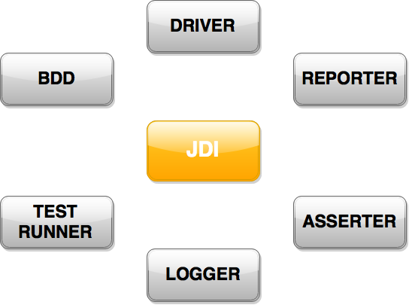
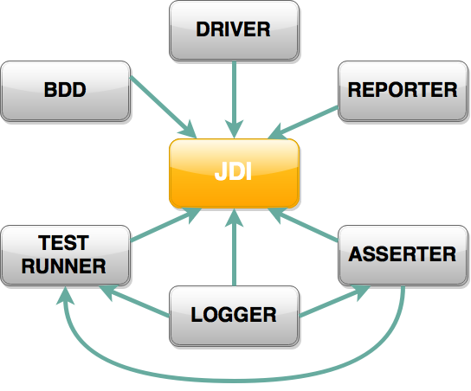

MODULE structure

Slide 28
matchers

Slide 29
matchers
Assert.contains("Test Text", "Text");
Assert.matches("1352-423-85746", "\\d{4}-\\d{3}-\\d{5}");
Assert.arrayEquals(searchResults, expectedResults);
Assert.listEquals(orders, expectedOrders);
Assert.each(searchResults).contains("IPhone");
Assert.each(searchResults).matches("IPhone \\d.*");
Assert.areEquals(() -> getNext(), "IPhone 6");
Assert.contains(() -> getNext(), "IPhone 5")
Assert.throwException(this::request, “Bad Request");
Assert.hasNoExceptions(this:: request);

Slide 30
matchers
new Check(“Search results are correct”)
.listEquals(searchResults, expectedResults);
ScreenAssert.matches("1352-423-85746", "\\d{4}-\\d{3}-\\d{5}");
Assert.ignoreCase().areEquals(result, "IPhone 6");
Assert.waitTimeout(2).contains(() -> result, "IPhone");
Assert.doScreenshot(SCREEN_ON_FAIL).isTrue(2 * 2 == 4);
Assert.fail(“Houston we have a problem”);
throw Assert.exception(“Something goes wrong”);

Slide 31
Demo: matchers
Notes:
LIVE demo
Есть готовые UI Objects. Переделка Селениум кода (с вейтами) под UI объекты

Slide 32
ENTITY TABLES

Slide 33
TABLE Annotation
@JTable(
root = @FindBy (css = “offers"),
row = @FindBy (xpath = ".//li[%s]//div"),
column = @FindBy (xpath = ".//li//div[%s]"),
header = {“ID", “Title", “Apply”}
rowsHeader = {"1", "2", "3", "4"},
headers = @FindBy(xpath = "//tr"),
rowNames = @FindBy(xpath = "//td"),
cell = @FindBy(xpath = "//li[{1}]/div[{0}]"),
footer = @FindBy(xpath = "//footer"))
public Table Offers;

Slide 34
TABLE Annotation
@JTable(
height = 4,
width = 3,
size = "3x4",
rowStartIndex = 1,
colStartIndex = 1,
headerType = COLUMNS_HEADERS,
useCache = false)
public Table Offers;

Slide 35
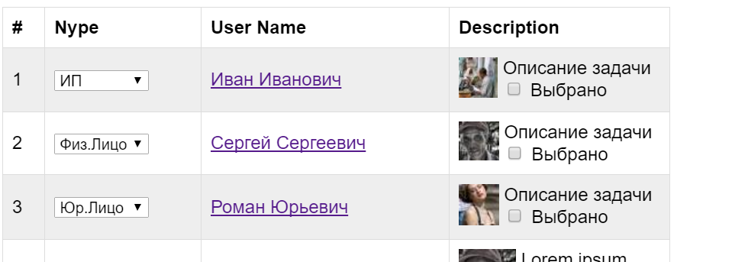
Complex table
@FindBy(id = “user-table")
public EntityTable<Entity, Row> Users =
new EntityTable<>(Entity.class, Row.class);

Slide 36
Table entities and rows
@Data public class Entity { public String number; public String type; public String userName; public String description; }
public class Row { public Text number; public Dropdown type; public Link userName; public Description description; }

Slide 37
Use table
Row user = Users.firstRow(r ->
textOf(r.description).contains(“задачи”) &&
textOf(r.type).equals(“ИП”));
user.Description.Select.select();
List<Entity> usersList = Users.entites();
Assert.entitiesAreEquals(usersList, ЭталонныйПользователь);
Column
Checkbox

Slide 38
Demo: entity table
Notes:
LIVE demo
Есть готовые UI Objects. Переделка Селениум кода (с вейтами) под UI объекты

Slide 39
PLAN
UI Objects. JDI
JDI. Composite elements
JDI Settings
JDI for any UI

Slide 40



Questions
roman.Iovlev
roman_iovlev@epam.com

